Slide 1
Local contexts and impact on women: NREGA in Kerala
Ratna M. Sudarshan, Director, ISST
(on behalf of ISST team)
IHD-ISST National Workshop on
National Rural Employment Guarantee in India – Lessons from Implementation

Slide 2
Team
Grace Fernandes Geraldine Fernandes | Kerala
Rina Bhattacharya Madhuri Karak | Himachal
Rina Bhattacharya | Rajasthan

Slide 3
Outline
About the study
Overview of work generated and systems of payment
Wider impacts
Programme Management
Challenges
Potential Development Impact

Slide 4
1. About the Study

Slide 5
Research Questions
What explains the observed differences in women’s participation in the NREGS?
What are the implications for household/ women’s well being?
What is the role of various institutions in explaining observed outcomes?
In what ways does the NREGA appear to be having wider development impacts?

Slide 6
Examining the NREGA: Women’s Participation and Impacts in Himachal Pradesh, Rajasthan and Kerala
Method:
- review of literature
- analysis of secondary data
- Structured interviews and group discussions with men and women who participate and those who do not; officials; other ‘key informants’

Slide 7
District data Kerala
Districts | HDI Rank | GDI Rank | Index of Deprivation | SC (% share of district population) | ST (%share of district population) | Female Work Participation | Rural BPL Families (as % share of rural families) | Female Headed Rural BPL Families
Idukki | 12 | 11 | 42.7 | 14.1 | 4.5 | 28.1 | 16.07 | 4.5
Kasargod | 11 | 8 | 37.6 | 7.5 | 2.5 | 20.8 | 37.59 | 9
Palakkad | 10 | 10 | 40.4 | 16.5 | 1.5 | 21.1 | 45.25 | 10
Wayanad | 13 | 12 | 46.3 | 4.2 | 17.3 | 22.8 | 42.8 | 6
Kerala | NA | NA | 29.5 | 9.8 | 1.1 | 15.4 | 36.56 | 7.2

Slide 8
NREGS performance
S No | Name of District | Year | Total No. of Households provided employment | Total persondays (lakhs) | No. of persondays claimed by women | Percentage of women’s participation
1. | Idukki | 2008-09 | 54,885 | 13.15 | 11.88 | 90.34
2 | Kasargod | 2008-09 | 25,346 | 10.51 | 8.33 | 79.25
3 | Palakkad | 2008-09 | 83,499 | 30.304 | 20.9 | 68.97
4. | Wayanad | 2008-09 | 53,438 | 21.95 | 15.38 | 70.06
 | KERALA | 2008-09 | 5,92,767 | 115.522 | 89.211 | 77.22

Slide 9
Profile – Palakkad and Kerala
% Rural Population | 86.38 | 74.03
% Urban Population | 13.62 | 25.96
% SC Population | 16.52 | 9.81
% ST Population | 1.51 | 1.14
Literacy Rate (M) | 89.7 | 94.2
Literacy Rate (F) | 79.3 | 87.86
% Main Workers (M) | 73.24 | 83.2
% Main Workers( F) | 26.75 | 70.5

Slide 10
Kerala- distribution of sample
Block | Panchayat | Village | Persons met
Malampuzha | Malampuzha | Malampuzha
 | Elapully | Mpuzha | 7 F, 5 M: NREGA
 | Marutarode | Polpully | 3 F, 3 M: non NREGS
 | Polpully | Elapully | ADS 20
 |  | Marutarode
 |  | Polpully
Attappady | Agali | Nakupathy | 32 F, 2 M: NREGS
 | Pudur | Nakupathy Ooru | 7 F, 1 M: non NREGs
 | Shaloyur | Vannanthara | ADS 16
 |  |  | Govt officials/ NGOs 8

Slide 11
Sample Blocks
Attapaddy - the block’s 39.05% ST population (Pudur panchayat has the highest ST concentration) is severely impoverished. IMR is 66, as compared to 12, the state level figure.
Malampuzha dam is the biggest irrigation project in Kerala with a large network of canals. A large percentage of the population is agricultural labour and paddy is the main crop. In the last decade there has been a proliferation of small scale industries. The Malampuzha Gardens is a popular state wide tourist destination.

Slide 12
2. NREGA Overview: Work days generated: share going to women

Slide 13
Total work days – women, by state

Slide 14
Share of person days to women (%) 2007
Share of Person days to Women (%) 2008-9

Slide 15
The outliers
Based on the 2007 data: Rajasthan and Kerala as states with high proportion of women to total NREGS workers + in the case of Rajasthan high absolute no. of workdays generated
Himachal as one of the states with very low proportion of NREGS workers being women

Slide 16
Variations observed across states and also within states in the percentage of work days going to women

Slide 17
Districts in Kerala: women’s share in work days by district

Slide 18
Palakkad: No of women/ total individual applicants
Kerala – variations within Palakkad district

Slide 19
Himachal: district wise variations in %age of women work days

Slide 20
Women’s share in employment generated, Sirohi Rajasthan

Slide 21
Wages: Varying interpretations
Wage payments systems have been interpreted differently
Kerala, Himachal: payment by days worked
Individual earning = number of days worked * min wages
Rajasthan: by work done

Slide 22
Malampuzha, Palakkad. Kerala. Average wage paid (min wage 125)

Slide 23
Himachal – average wage paid (Min Wage Rs 100)

Slide 24
Time rate or piece rate
Payment patterns vary – Kerala, Himachal,
In Rajasthan, computed as [value of completed work/ no of workers on muster roll] so actual earnings below min. wage; however trend increase over time

Slide 25
Sirohi, Rajasthan – average wages paid (Min Wage Rs 100)

Slide 27
Time rate or piece rate
Reasonably assured cash transfer – greater dependence?
Vs uncertain earnings – greater value to assets created?

Slide 28
3. Wider Impacts

Slide 29
Wider Impacts
Market wage for men (200+)> min wage (125)- little impact on male work choice/ migration
Market wage for women < min. (70-80)–some evidence of upward pressure on women’s market wages
Any impact on wage inequality will depend on trends in market wages for both men and women
60% of earnings reportedly saved

Slide 30
Impact on agriculture
Reported shortage in female labour for work on farms and decline in area under paddy cultivation
Elapully gram panchayat in Malampuzha block - NREGS agriculture work day calendar. NREGS works (March – June; November – December) – 6 months
agricultural work (July – October; January – February) – 6 mths

Slide 31
4. Programme Management

Slide 32
Management Capacity
Management of worksites entrusted to Kudumbashree (state poverty eradication mission)
Area Development Supervisor (women) maintain muster rolls, etc. Typically educated, between 32-45 years, attends a minimum of 10 meetings a month.
Prior experience both of ADS + women organised into groups for micro enterprise

Slide 33
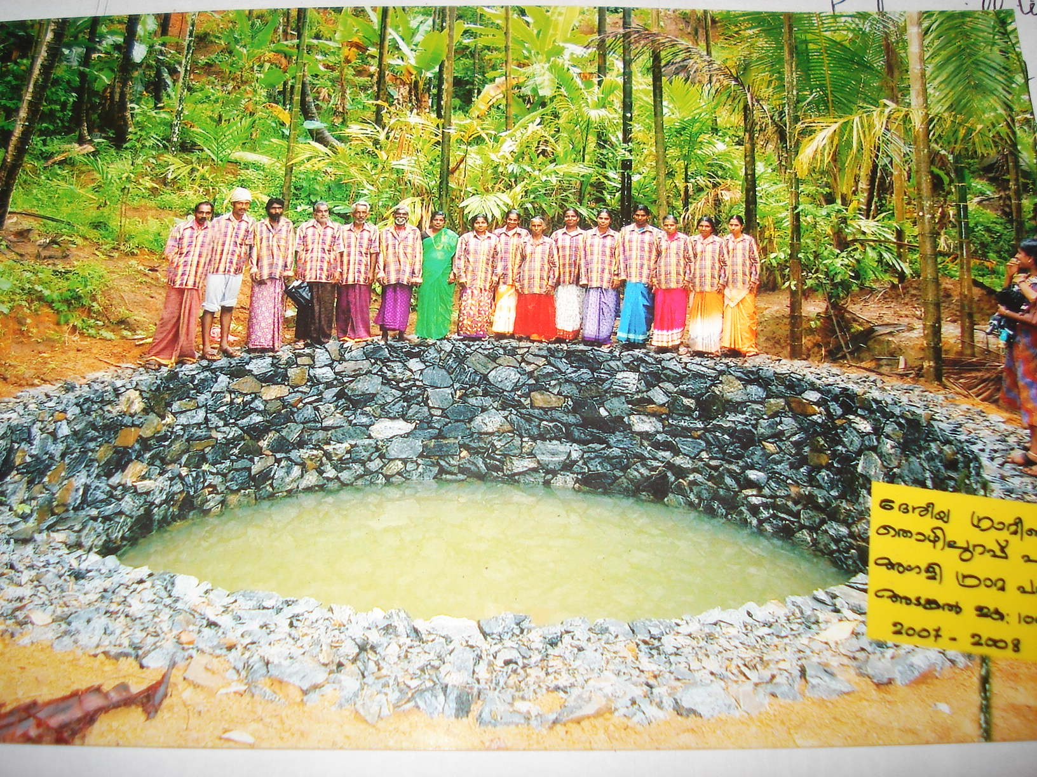
ADS in charge of whole group

Slide 34
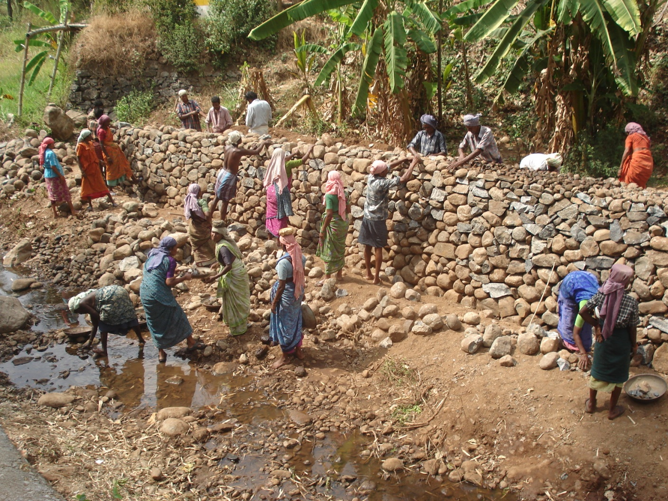
Kerala

Slide 35
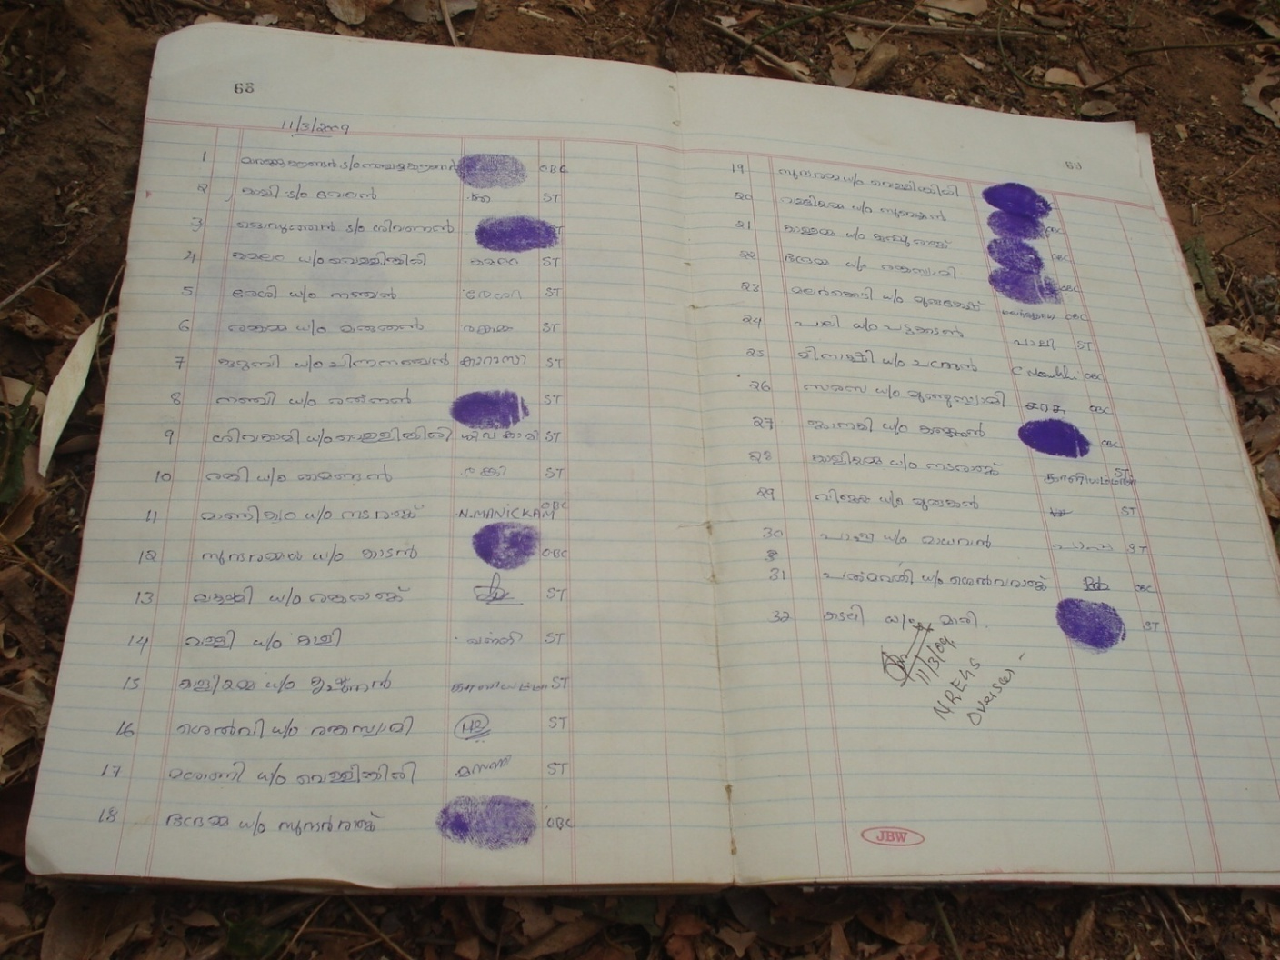
Muster roll, Kerala

Slide 36
5. Challenges

Slide 37
Implementation concerns
Technical and admnve problems such as
- extensive paper work- backlog, need to stop works
- online data entry reqd but power cuts
- delays in inspection/ payment

Slide 38
Local Contexts: Kerala
Even with good management systems, some participate much less
  Young women with young children (< 30 years)
  Tribal areas – Attapady –
    Dispersed settlements, hilly terrain - difficult to mobilise into groups,
    distance to site greater,
    activities not always suitable to area;
    formation of Kudumbashree ‘adivasi only’ groups in progress

Slide 39
Challenges
Non serious registration (has come down > 50 % in the first year and down to > 10 % in year 2)
Stoppage in extreme rainy season
Does time rate mean lower output?
Marginal farms facing labour shortage
Inadequate logistic and infrastructural support – not enough bank branches, especially in tribal areas; delays in computation and transfer of wages to workers’ accounts.
Software used by the panchayats and the banks is different. + frequent power cuts
Implements can be bought only once in a given year - broken tool pieces by year end
Innovative types of works need to be formulated for plantation areas.

Slide 40
Involving women
Issue not just of women’s participation at worksite but also in management, choice of works
Kudumbashree groups are an exception – strong management, women’s groups, embedded in panchayat structure
Himachal: eg Sangrah village; Sangrah panchayat: Long established mahila mandal not active participant in NREGA
Possibility of partnerships between panchayat and independent groups??

Slide 41
6. Potential development impact

Slide 42
Development impact
Quality of assets
Trajectories: complementary, competing?
Example from Himachal: Unrestrained open cast limestone mining alongside gully plugs and tanks under the NREGA
(Ganog panchayat, block Sangrah, district Sirmour)

Slide 43
Employment or social protection?
The universal need is for wage work beyond 100 days, because it is insufficient for sustaining a household. Not a substitute for regular work?
The NREGS assures some basic income against work – no protection against ill health

Slide 44
Thank you

