Slide 1
MGNREGA: wage work, unpaid work, and care
Ratna M. Sudarshan
Institute of Social Studies Trust, New Delhi

Slide 2
Participation
The programme guidelines require 1/3 rd of work created to go to women
Data shows wide variations around this proportion between states (also within states)
Objective of this study was to examine through fieldwork in selected parts of Kerala, Himachal Pradesh and Rajasthan reasons behind and implications of the observed variations

Slide 3
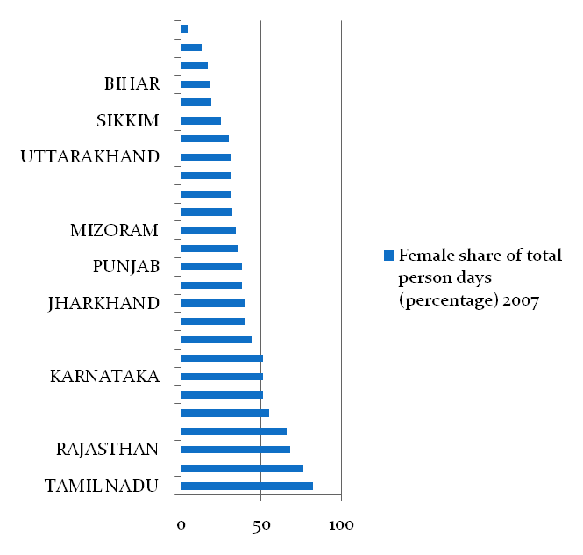
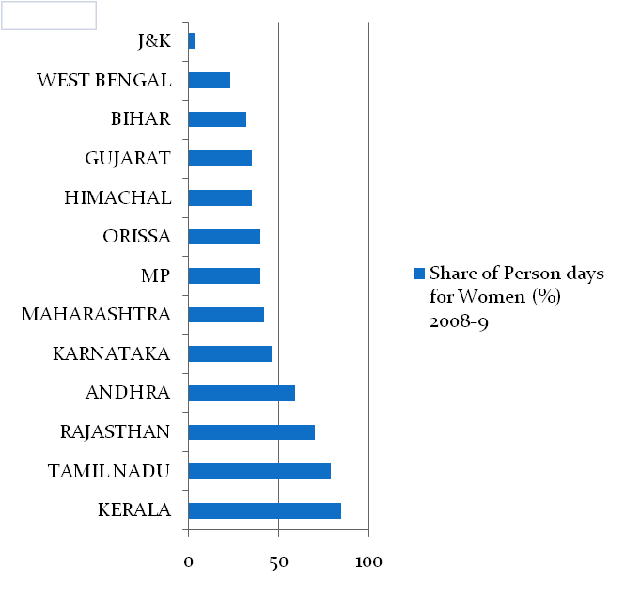
Share of person days to women (%) 2007
Share of Person days to Women (%) 2008-9

Slide 4
Level of women’s participation
Programme designed for ‘able bodied, willing to do manual labour’
Labour market factors: Market wages for men and women in relation to minimum wages offered on NREGA sites; Non availability of other work within or near village
Intra-household factors: No of earners in the household; Age and care responsibilities; unpaid work, other household responsibilities

Slide 5
Participation
Context/ underlying factors
Himachal: hill state: Scattered population, low density of population;
Most households own some land, fetching water/ fodder/ fuel women’s responsibility, no tradition/ time for wage work
NREGA attractive mainly to hardest to reach migrant women

Slide 6
Participation
Rajasthan: drought prone state; tradition of ‘famine works’ and women’s participation on these works
Kerala and Rajasthan: much higher percentage of women in total NREGA work force than in overall work force

Slide 7
Institutional frameworks
Panchayat entrusted with overseeing implementation, choice of works
Kudumbashree in Kerala – State poverty eradication mission, women’s self help group structure: embedded in panchayat structure pre existing management skills.
Abu Road, Rajasthan – NGO and youth groups actively contest any observed irregularities
Himachal –women’s groups not involved directly even where present

Slide 8
Some observations
Little impact on male work choice/ short distance migration
Reported shortage in female labour on farms
Some evidence of upward pressure on women’s market wages
Impact on gender wage inequality not yet known - will depend on trends in market wages for both men and women
Some savings reported; personal consumption expenditure by women

Slide 9
In conclusion
Design assumes large numbers of able bodied manual work seekers – true of Rajasthan, Kerala, but not Himachal
Potentially: women’s participation on a regular basis may change attitudes towards wage work outside the home
As of now: no evidence of changing gender norms – eg sibling care in Rajasthan, absence of young women on Kerala worksites

Slide 10
Policy recommendations
‘tweaking’ – creche +carer; for the old, pregnant women, designate lighter/ other work
Cash transfers where low participation and very scattered, low density population?
Engaging women’s groups where they already exist – choice of works, priorities
Linking child care to women’s work programme design more fundamentally

